Slide 1
Hierarchical reward task
department < ... >
research group < ... >
Lab presentation 23/03/2021

Slide 2
Recap

Slide 3
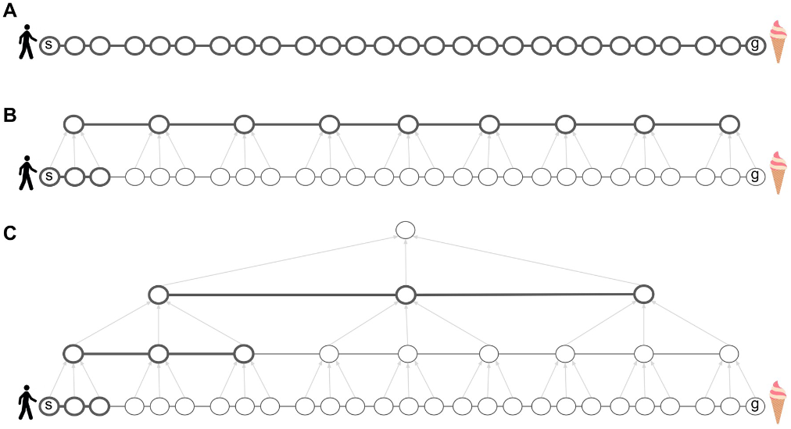
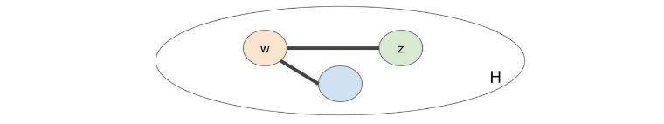
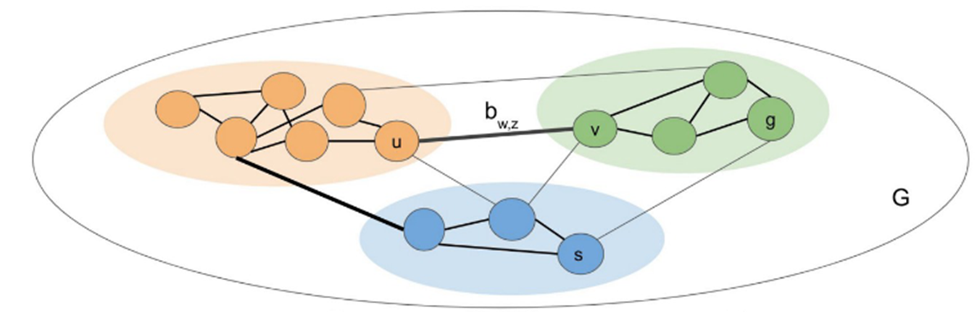
Hierarchical representations
Decision making
Tomov et al. (2020)

Slide 4
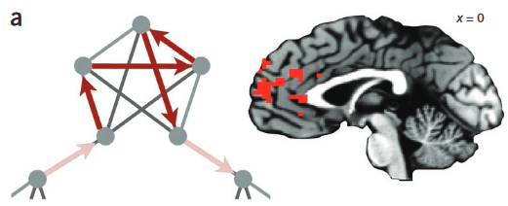
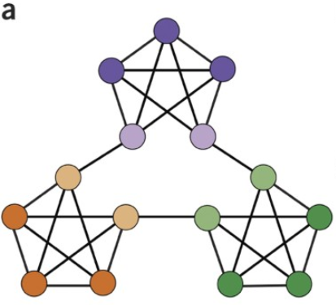
Hierarchical representations
Event segmentation
Schapiro et al. (2013)

Slide 5
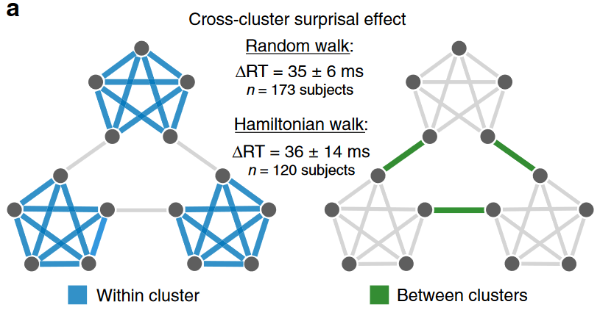
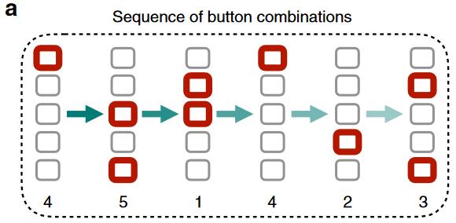
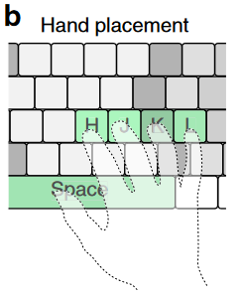
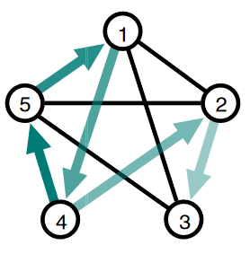
Hierarchical representations
Reaction times
Lynn et al. (2020)

Slide 6

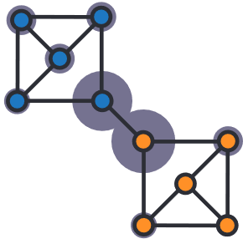
Hierarchical representations
Decision making
Diuk et al. (2008)

Slide 7
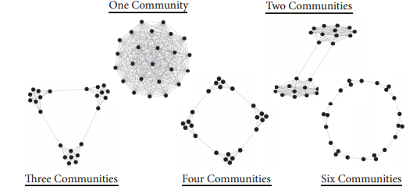
Hierarchical representations
Larger state space
35 minutes
1.5s stimulus
No ISI / fixation
Detection from canonical rotation
Karuza et al. (2019)

Slide 8
What’s Next?

Slide 9
Questions
Does this influence decision making behaviour?
State space representation
Can we detect specific influence in EEG
State space for RL: RewPos
Statistical learning in general: N2/P3

Slide 10
New Task

Slide 11
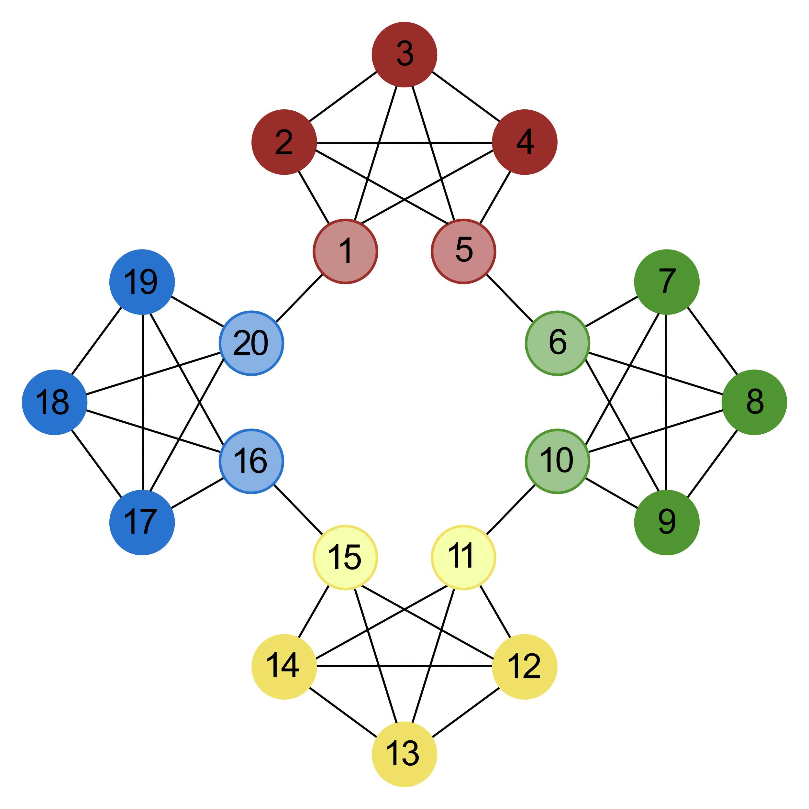
Online pilot
Behavioural task / learning
Starting positions
Goal positions
Points
15 Steps
Differing policies

Slide 12
Online pilot
Stimuli

Slide 13
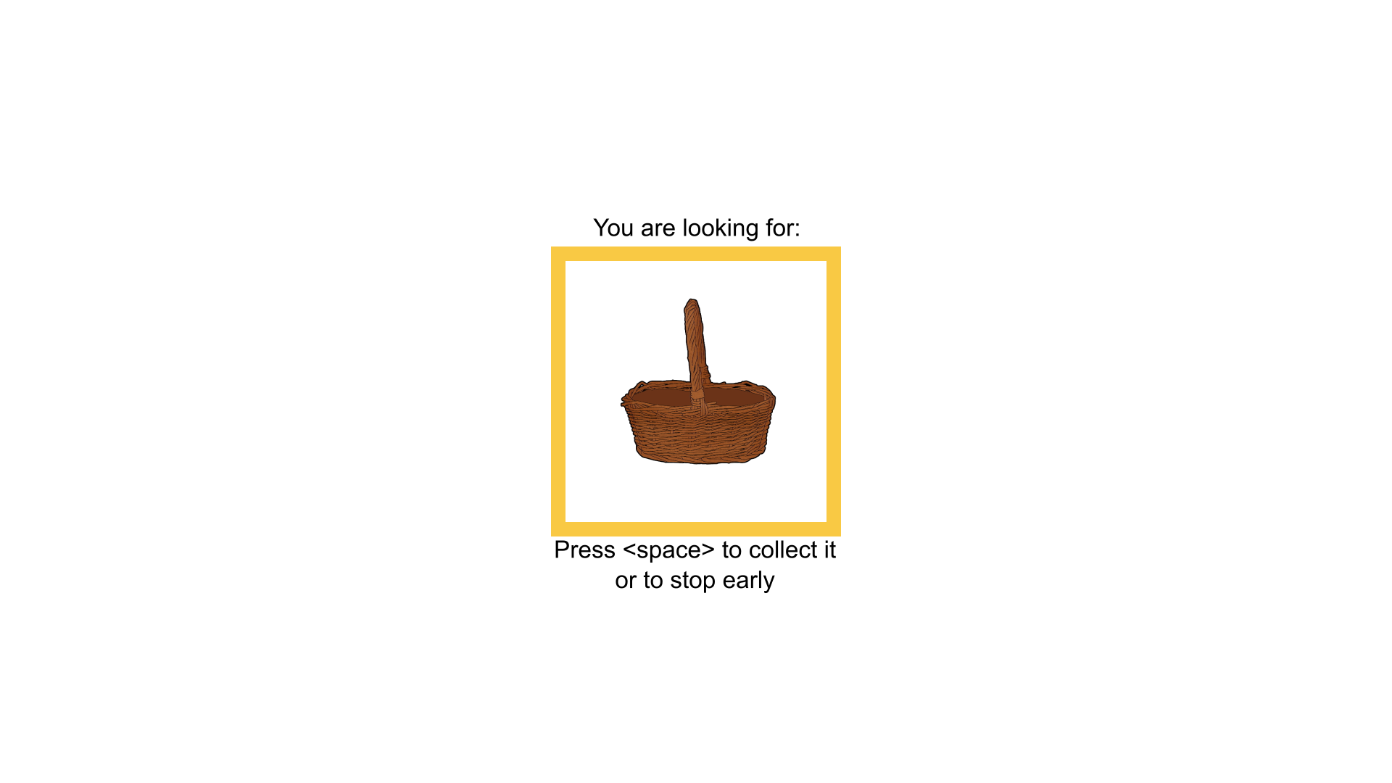

Slide 14

Start with 5 points
Decrease or increase with every room
Forced choice!
Tracker?

Slide 15
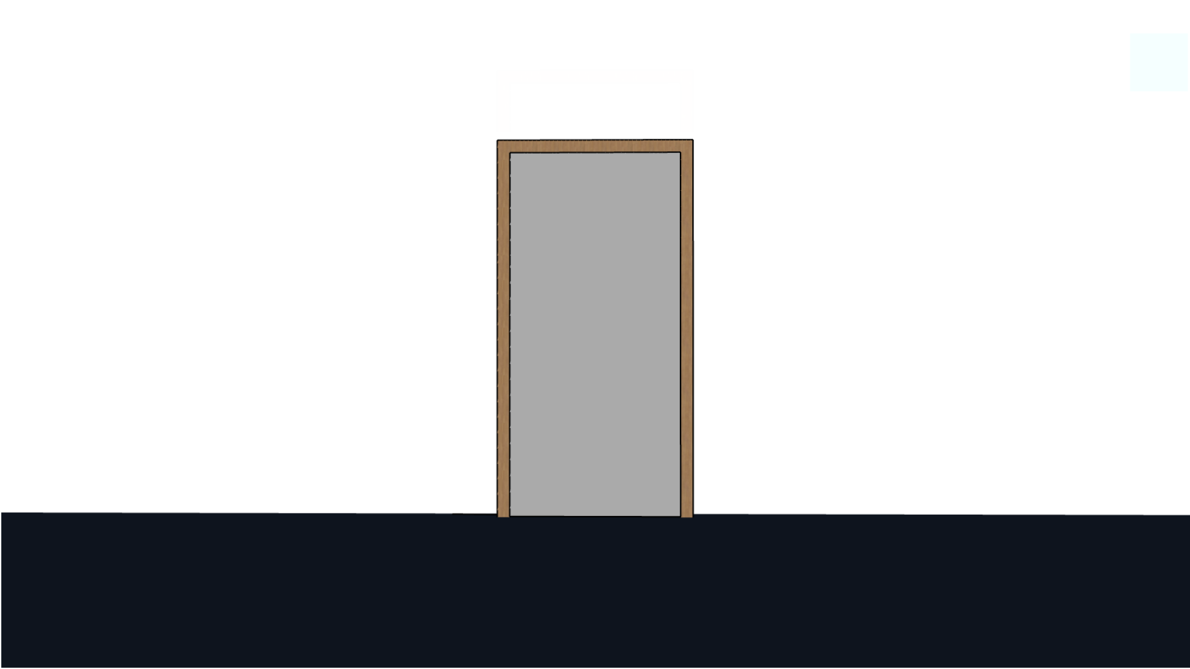
Fixation cross drawn in jsPsych
+
+

Slide 16


Slide 17
+

Slide 18


Slide 19
Online pilot
Feedback screen
Points
Miniblocks left

Slide 20
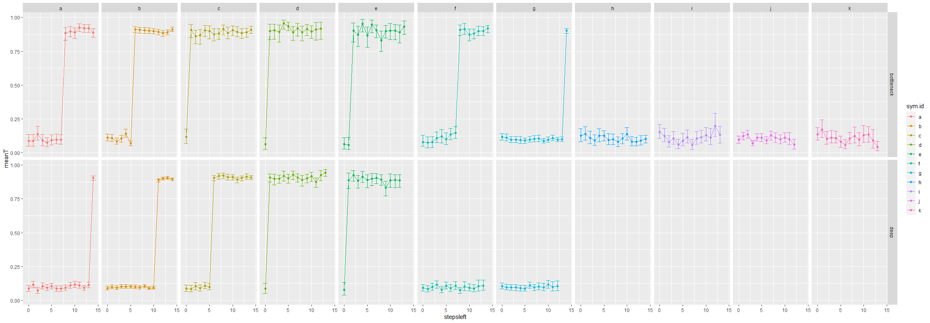
Simulations
Simulated optimal betting choices (with 10% chance of error – noise)

Slide 21
Simulations
Unrealistic but:
Test some model comparisons

Slide 22
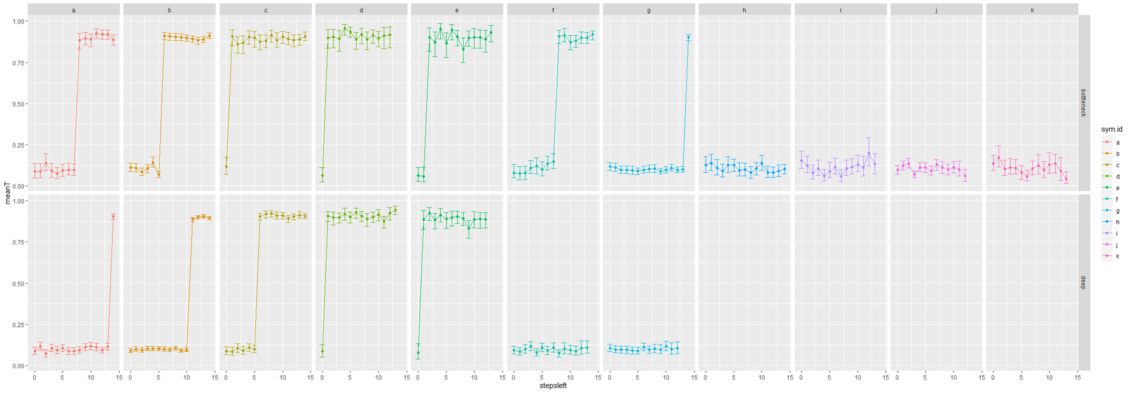
Fully specified model
Y ~ Bern[ (α|sym.id, stepsleft) + (u|sym.id, stepsleft, pp) ]
For 2 participants: 811 parameters

Slide 23
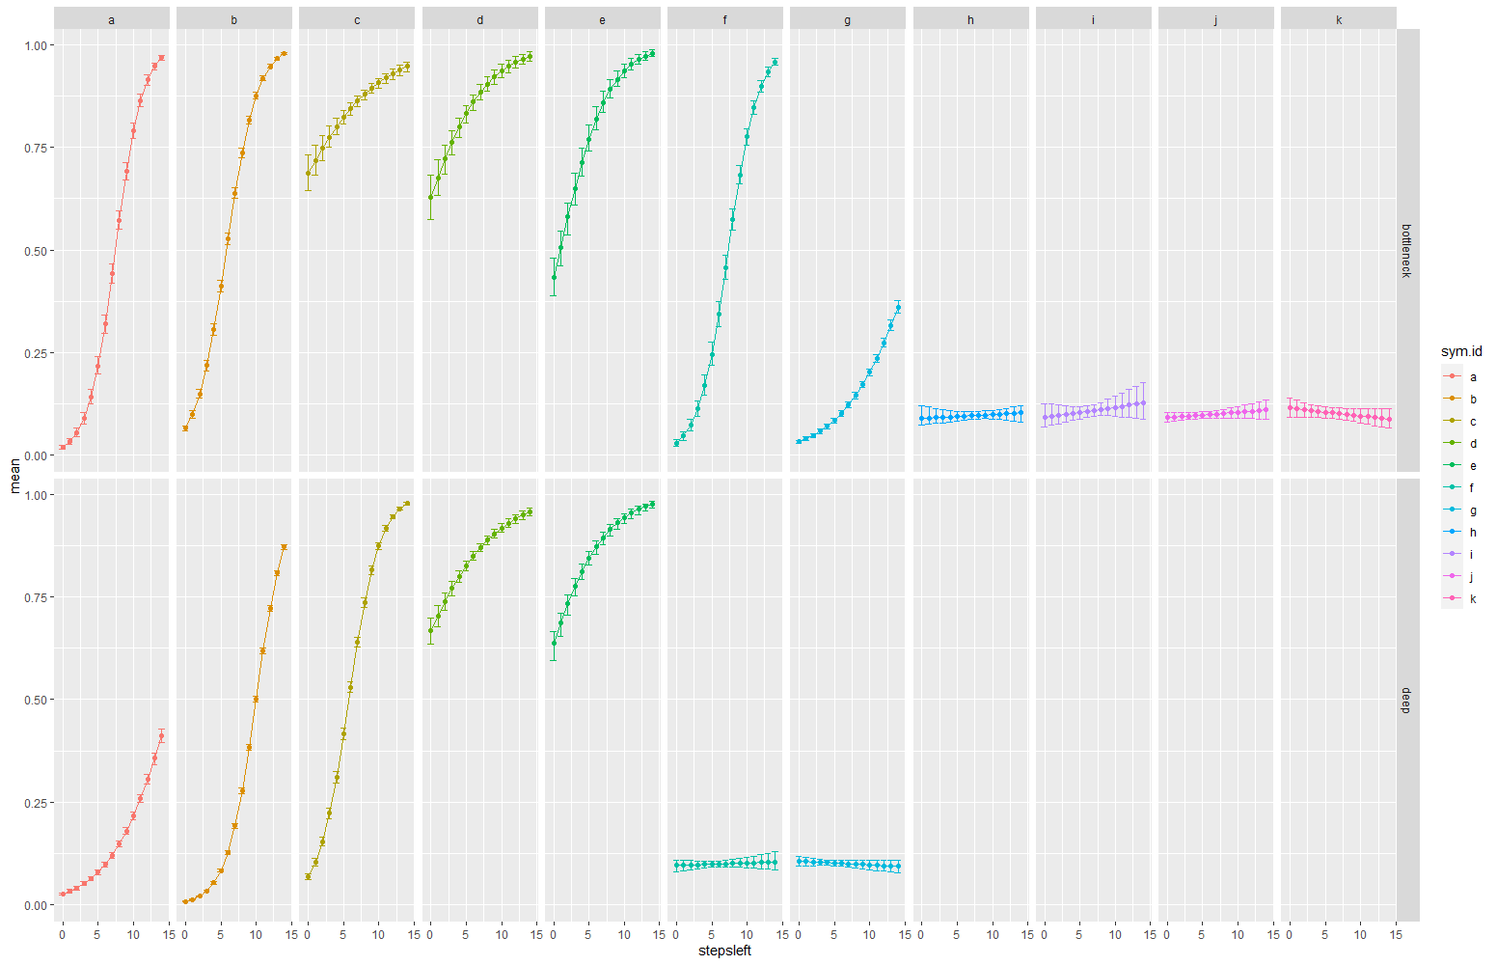
Linear-logistic regression
Y ~ Bern[ {(α|sym.id) + (u₁|sym.id,pp)} +
{(β|sym.id) + (u₂|sym.id,pp)}*stepsleft } ]
For 2 participants: 109 parameters
BF (full vs linear) = 5.8*10¹⁷

Slide 24
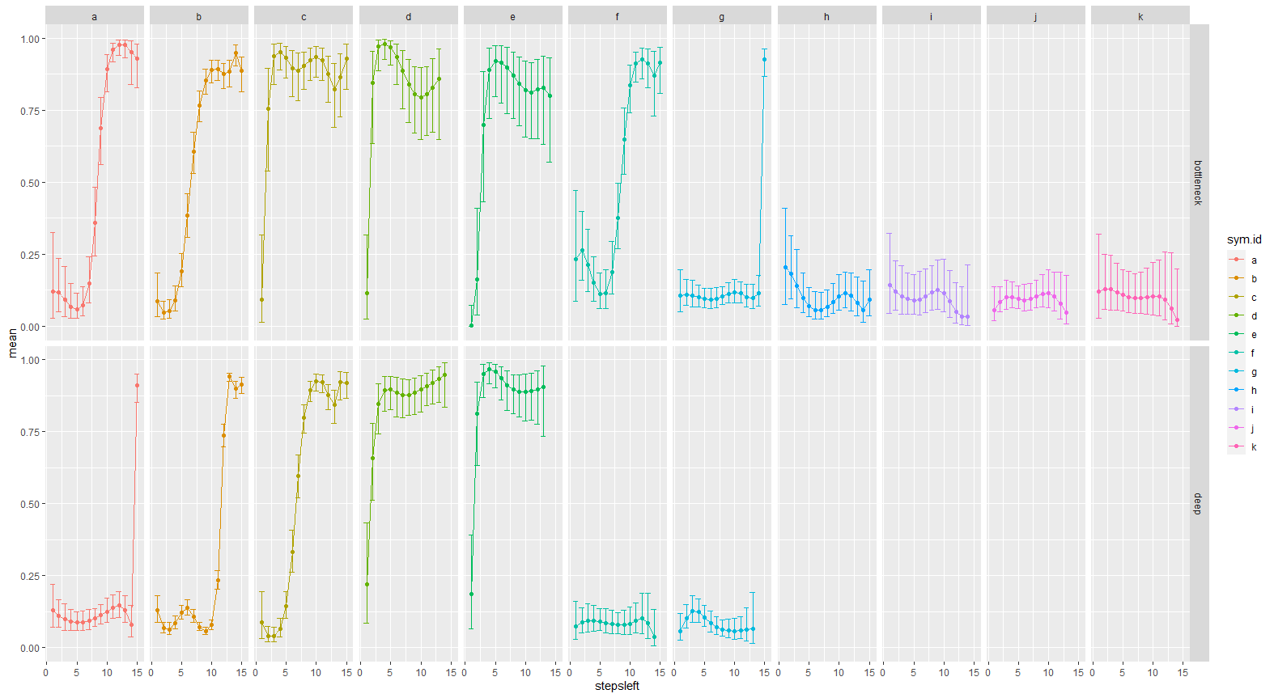
Spline logistic regression
Y ~ Bern[spline equation over stepsleft – 4 knots, deg 3]
For 2 participants: 451 parameters
BF (spline vs full) = 8.35*10¹³

Slide 25
Simulations
Spline over stepsleft as baseline / ‘null’?
Compare versus ‘theoretical’ regressors

Slide 26
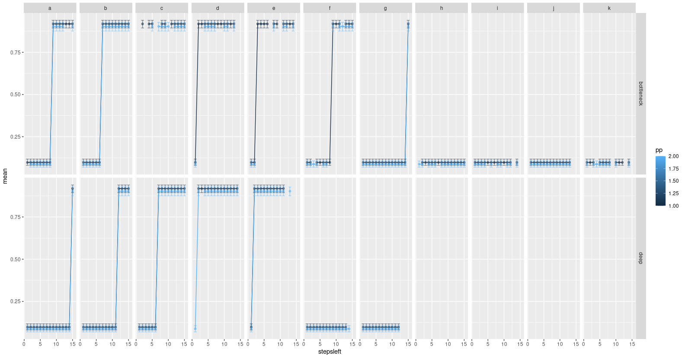
Optimal choice logistic regression
Y ~ Bern[ {(α) + (u₁|pp)} +
{(β) + (u₂|pp)} * opt.choice ]
For 2 participants: 7 parameters
BF (opt vs spline) = 2.13*10⁸⁷

Slide 27
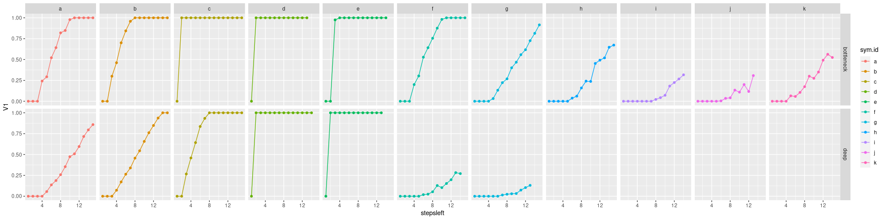
Simulations
Choice based on EV

Slide 28
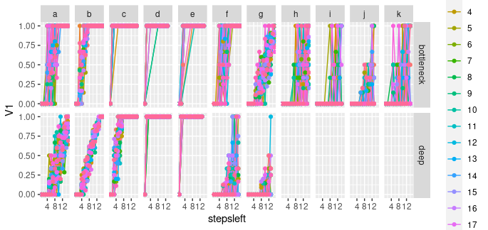
simulations
Individual differences

Slide 29
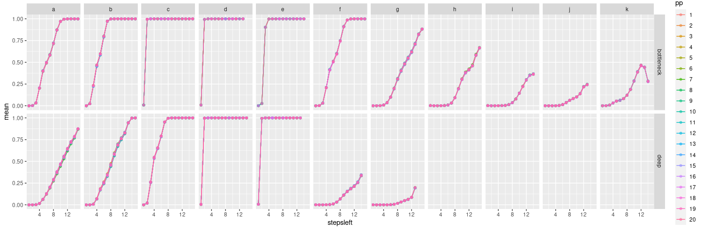
simulations
Spline

Slide 30
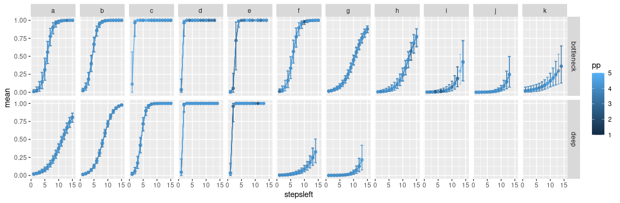
simulations
Linear
BF (linear vs spline) = 506.62
For 5 pp: 217 parameters

Slide 31
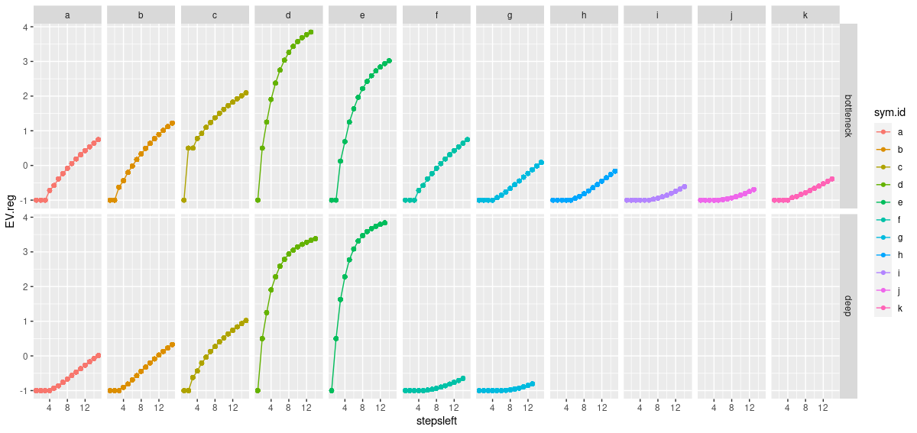
Simulations
Improve with & test theoretical effect?

Slide 32
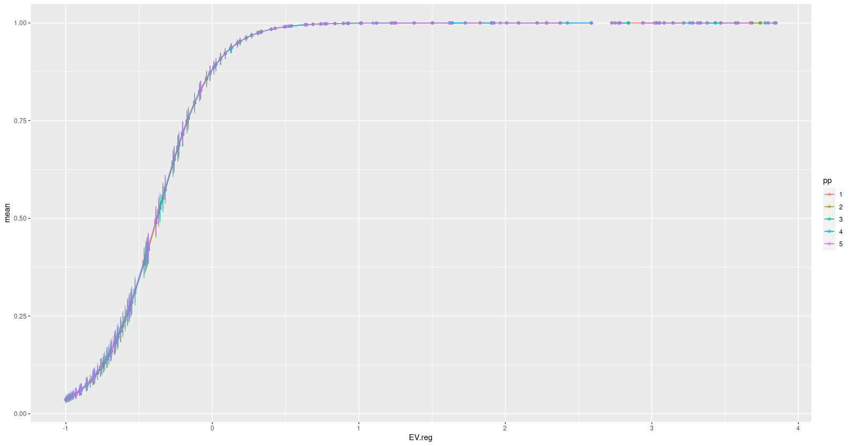
simulations
Y ~ Bern[ {(α) + (u₁|pp)} +
{(β) + (u₂|pp)} * EV]
For 5 pp: 14 parameters
BF (EV vs linear) = 8.53*10²⁷

Slide 33
simulations
More realistic simulations:
Assume linearity?
Follow EV?
Covariates?
Current bet
History (pp not markov?)
Group cluster?

